Slide 1
Wireless Laboratory Enclave
Jessica Bhattacharyya

Slide 2
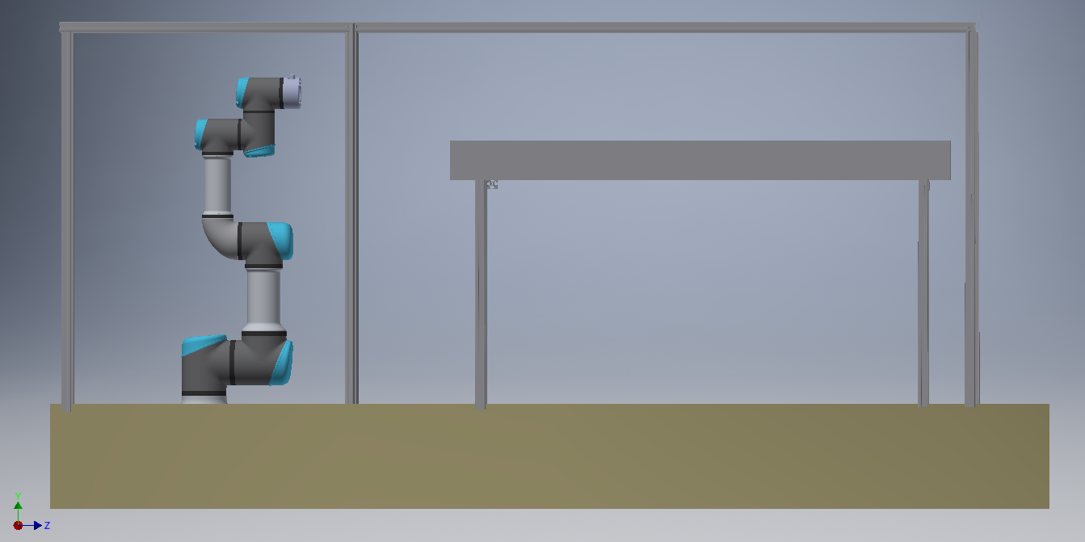
Design
Robot located on half of table
Space for X-Carve
Support beams one-third of way along main enclosure
X-Carve supported on smaller beams
Space alongside for computing

Slide 3
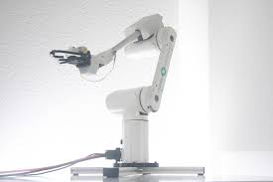
Robot
Mover6 Robot
Grippers installed
Wide range of movement
Not capable of holding object still under X-Carve

Slide 4
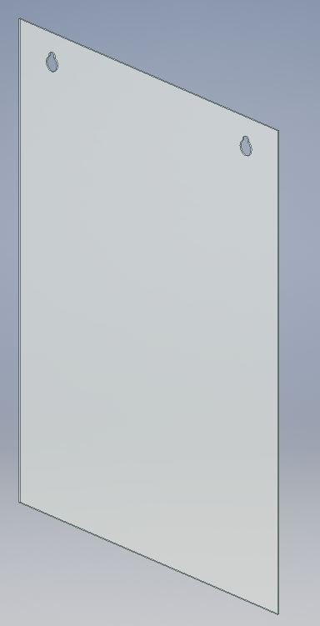
Safety
Removable Plexiglass walls
Instead of light curtain; too expensive
Door with emergency stop if opened
Limit Switch
To access and maintain the robot

Slide 5
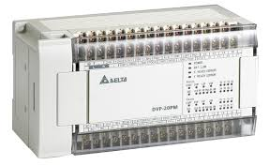

Future Work
Implementation of Mover6 and emergency stop into PLC system
Create panel for placement of PLC alongside enclave
Design wiring system of emergency stops

